Slide 1


TIME MANAGEMENT
LANDMARK
UNIVERSITY
TMC 411
PROF. J. O. OJEDIRAN

Slide 2
"Time is the coin of your life. It is the only coin you have, and only you can determine how it will be spent. Be careful lest you let other people spend it for you."
-Carl Sandburg
All our dreams can come true if we have the courage to pursue them.
- Walt Disney

Slide 3
OUTLINE
Introduction
Conceptual clarifications
Strategies for effective time management
Conclusion

Slide 4


Introduction
No doubt, more responsibilities are now added to your portfolio.

Slide 5
Introduction
These new responsibilities come with new expectations.
Your ability to meet these expectations successfully is what guarantee your excellence.
In this class, I will be teaching you how to manage your time effectively and efficiently.

Slide 6

TIME MANAGEMENT
Time management refers to the coordination of tasks/activities to maximize the effectiveness of efforts.
Time management is the process of planning and exercising conscious control of time spent on specific activities - especially to increase effectiveness, efficiency, and productivity.
Good

Slide 7
Time Management
To manage your time effectively and efficiently as a student can be challenging, but essential for achieving academic and leadership excellence.
This is because you will be required to mix academic rigor with extracurricular activities and leadership roles.

Slide 8
Strategies for
Effective and Efficient
Time Management

Slide 9
Strategies for Effective Time Management
God owns
your time
Prioritize
tasks
Create a schedule
Set SMART goals
Eliminate distractions
Learn to say no
Seek
support
Stay
organized
Practice
self-care
Good

Slide 10

GOD OWNS YOUR TIME
Acknowledge that your
times are in God’s hand.
“My times are in thy hand” (Ps. 31:15).
And that without God, you cannot achieve anything, talk less of excellence.
“…for without me ye can do nothing.” (Jn. 15.5).
Hence, give God your time.

Slide 11
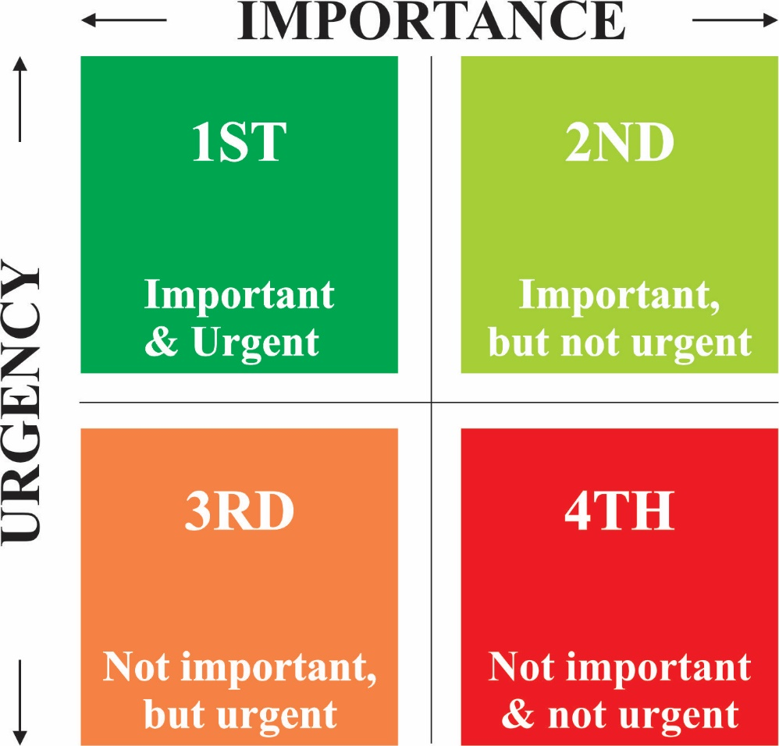
PRIORITIZE TASKS
Identify your most
important and urgent tasks, and
allocate your time accordingly.
All things are lawful unto me,
But all things are not expedient:
All things are lawful for me, but all things edify not (ICor.10:23, ICor. 6:12)

Slide 12


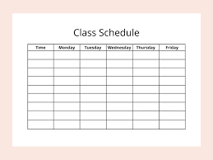

CREATE A SCHEDULE
Create a (daily, weekly & monthly) schedule.
Plan your activities and tasks in advance such as time for classes, study sessions, meetings, and leadership responsibilities.
Knowing what you need to do in the coming days, weeks or months can help you greatly.
Use a digital calendar or a physical planner to stay organized.

Slide 13

SET SMART GOALS
Set SMART objectives:
Simple/specific
Measurable
Achievable/attainable
Realistic
Timely/time-bound
Knowing what you want to achieve will help you prioritize your tasks.

Slide 14

ELIMINATE DISTRACTIONS
Avoid distractions (internal & external)
Distractions are time wasters.
Identify common distractions and do
your best to minimize/eliminate them during
designated study or work times.
This may involve finding a quiet study space, or using website blockers to limit access to distracting websites.

Slide 15

LEARN TO SAY NO
You are being asked to take on various responsibilities
It's essential to set boundaries and say no when you're stretched too thin.
Be selective and don't overcommit.
Overcommitting can lead to burnout and negatively impact both your academics and leadership role.
Politely decline opportunities that you can't manage effectively.

Slide 16
STAY ORGANIZED
Keep your workspace, both physically and digitally, organized.
Being able to quickly access what you need will save you time and reduce frustration.
This is important because looking for what is not lost can be very frustrating.

Slide 17

Practice self-care
Take care of yourself.
Rest, exercise and relax.
“… and he rested on the seventh day”
A healthy and well-rested leader is more effective in both academic and leadership roles.

Slide 18



Seek support
Do not be ashamed to ask for help.
Ask for help or support from professors, lecturers, peers, or mentors when needed.
They can offer guidance and help you navigate your responsibilities more efficiently.

Slide 19
Conclusion
Remember that managing time effectively as a student is an ongoing process.
It's crucial to be flexible and adapt your strategies as your responsibilities and circumstances change.
With practice and persistence, you can balance your academic and other commitments successfully.

Slide 20
YOU WILL
EXCEL AND
SUCCEED!

Slide 21
Good
Seest thou a man diligent in his business? he shall stand before kings; he shall not stand before mean men.
- Prov. 22:29

Slide 22


